Slide 1
Designing Interactive Reports in Power BI Desktop
Notes:
This module demonstrates how to use the report design features of Power BI Desktop to create reports using the standard set of Power BI visuals. The module teaches students how to add effective interactive behavior to Power BI reports using slicers, visual highlighting and drill actions. The module takes students on a tour of the custom visuals available in the Power BI Custom Visuals Gallery and explains how to import custom visuals into a Power BI Desktop project. The module introduces the fundamental concepts of Row-level Security (RLS) in the Power BI platform and demonstrates the steps required to implement RLS in a custom solution. The module concludes with a discussion of publishing a Power BI Desktop project to the cloud in the Power BI service and taking advantage of Power BI platform’s Publish To Web feature.

Slide 2
Agenda
Designing Interactive Reports
Creating the Top 5 Products List
Working with Bookmarks and Drillthrough
Using Report Themes
Importing Custom Visuals
Publishing Power BI Reports

Slide 3
Creating Reports
Power BI Desktop project contains one report
Report within project can contain multiple pages
Report pages contains visuals
Reports can be created using filters
You can add filter to a specific visual
You can add page-level filters
You can add report-level filters
You can add interactive filters

Slide 4
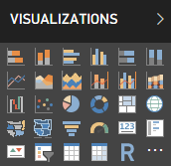
Built-in Visualization Types
Table and Matrix
Bar charts and Column charts
Pie charts and Doughnut chart
Line chart and Area chart
Scatter chart and Combo charts
Card and Multi-row Card
Treemap
Ribbon chart
Waterfall chart
Funnel chart
Gauge
Map and Filled Map
Slicer
R script visual
Shape map (in preview)

Slide 5
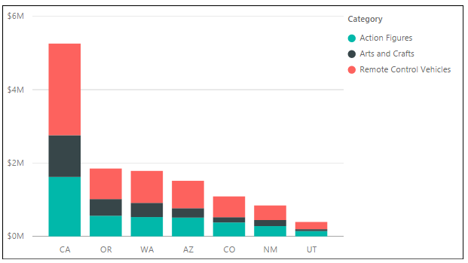
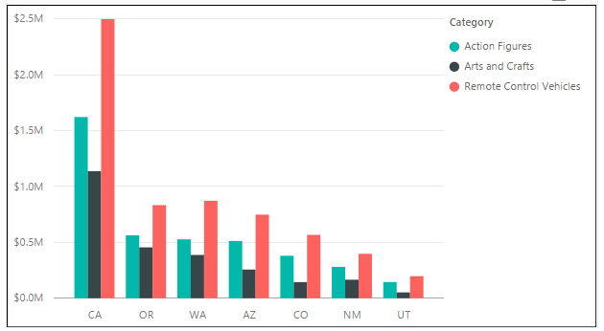
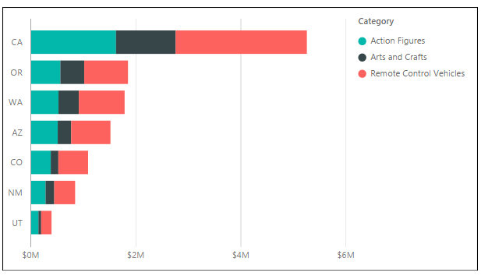
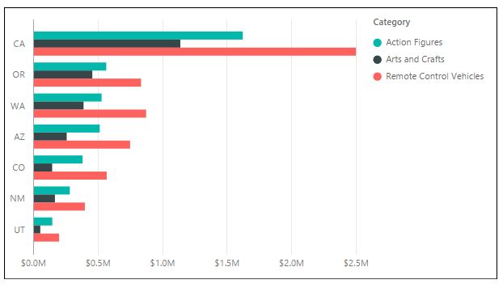
Column Chart and Bar Chart Variations
Stacked Column Chart and Clustered Column Charted
Stacked Bar Chart and Clustered Bar Chart

Slide 6
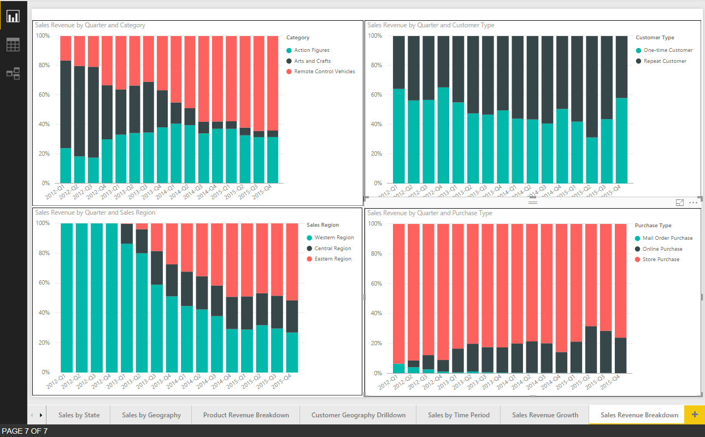
100% Stacked Column Chart
Used to visual distribution over time across categories

Slide 7
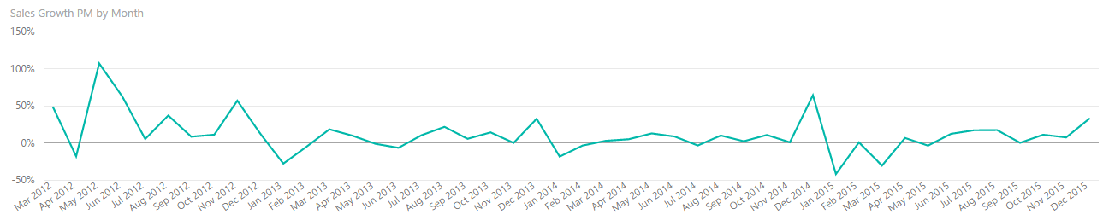
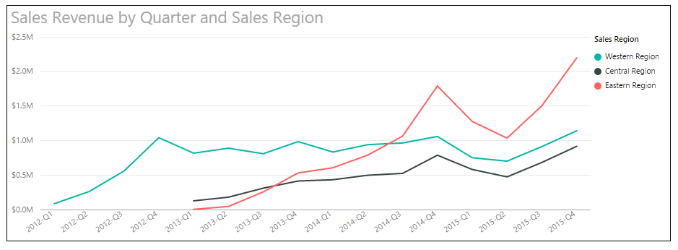
Line Charts
Visualizes a series of data points across X and Y axis
Commonly used for time-based analysis
Add field to Legend to create multiple lines for comparative analysis

Slide 8
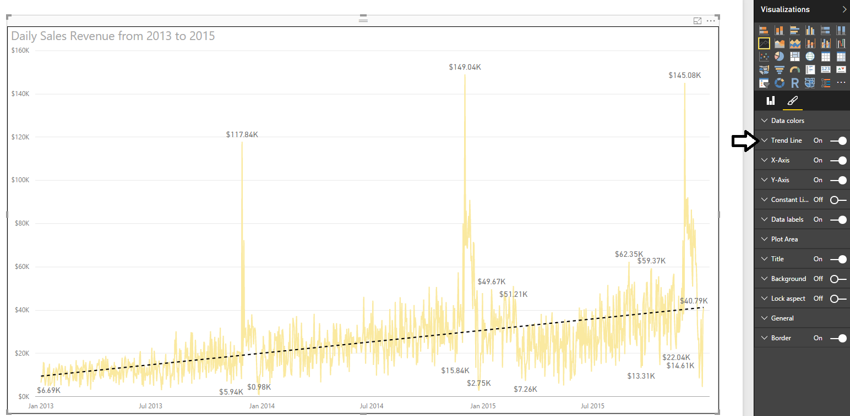
Trend Lines
Used to visualize trends in series-based data
Flattens out the ups and downs
Used to determine if values are trending up or down

Slide 9
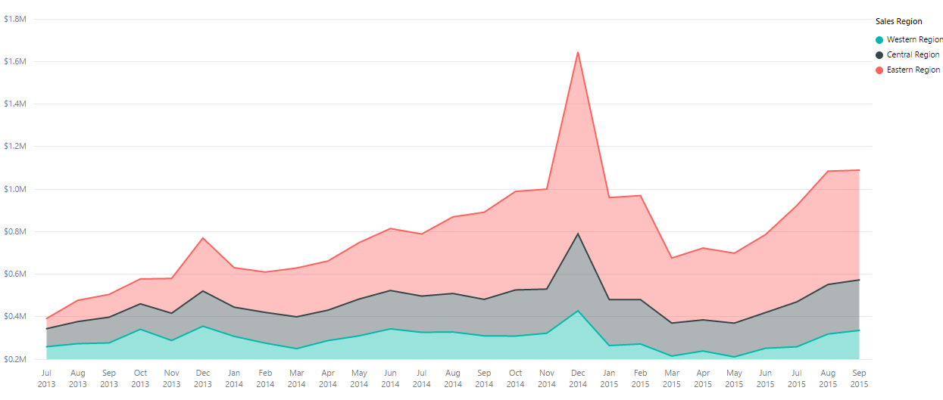
Stacked Area Chart
Basically, a line chart with a little more personality
Areas under lines filled with colors

Slide 10
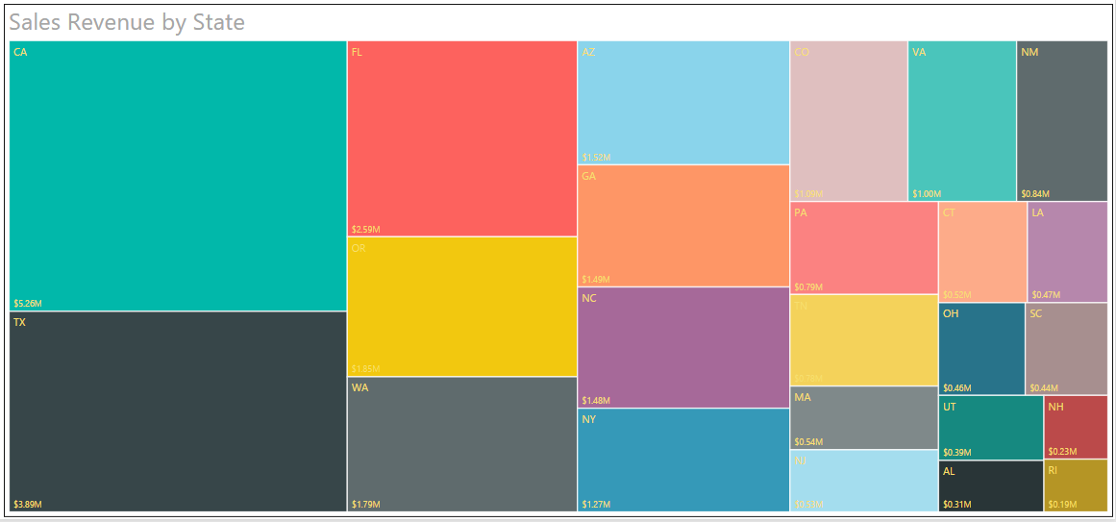
Treemap
Simple visualization of category distribution

Slide 11
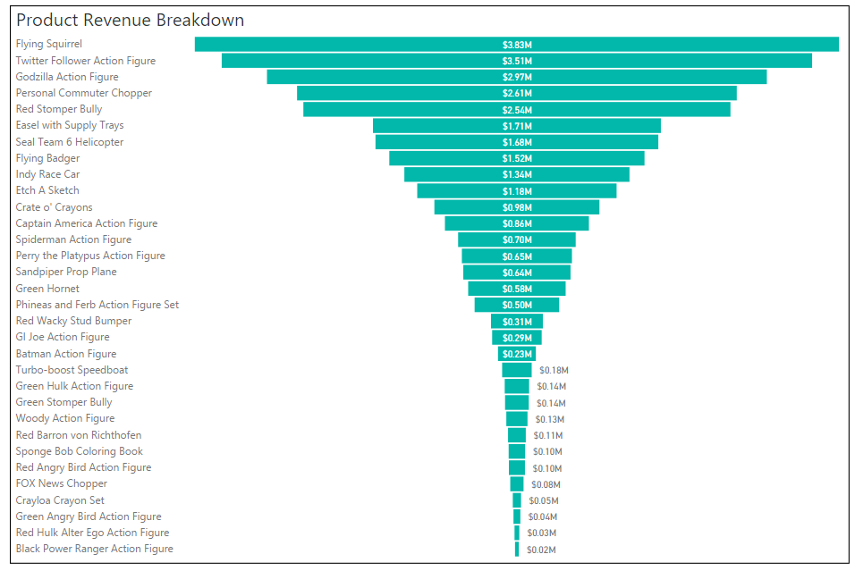
Funnel
Visualizes distribution across categories as percentage of top value

Slide 12
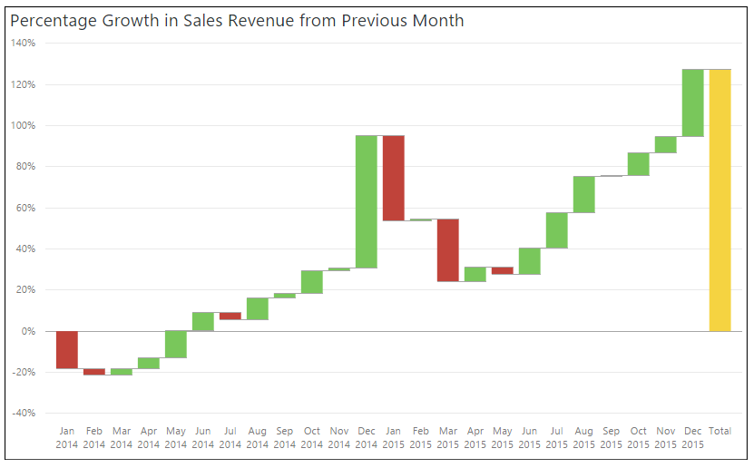
Waterfall
Visualizes series-based data with positive and negative values

Slide 13
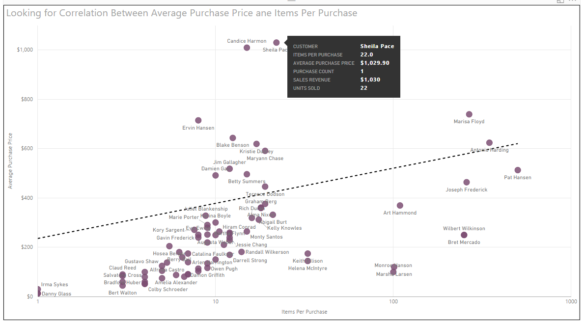
Scatter Chart
Visualizes set of data points when looking for correlation
Scatter chart used to discover correlation between two variables
Each data point has two values which are mapped to X and Y axis
How does number of items purchase per customer affect average purchase price?

Slide 14
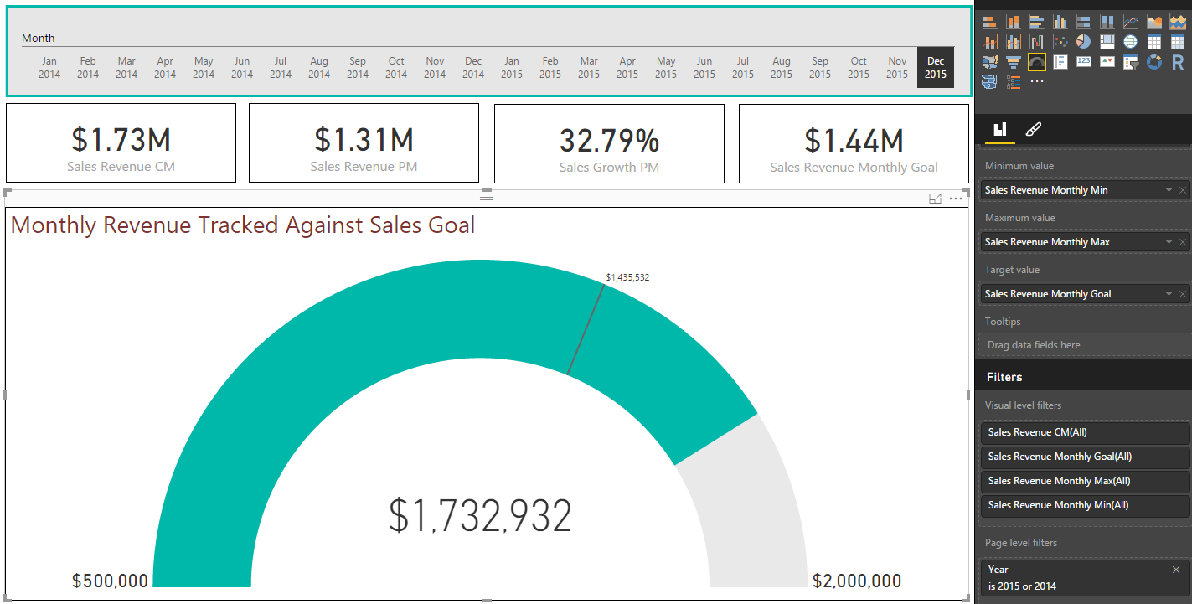
Gauge Visual
Visualizes how measured value is tracking against goal or budget

Slide 15
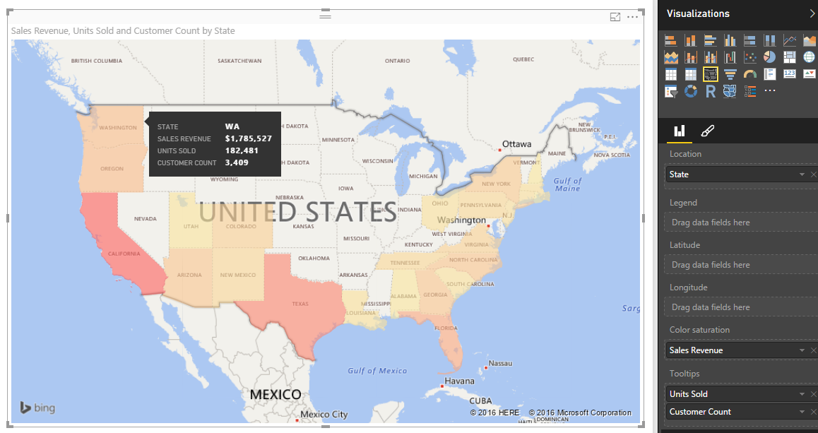
Filled Map
Visualizes distribution across states and countries

Slide 16
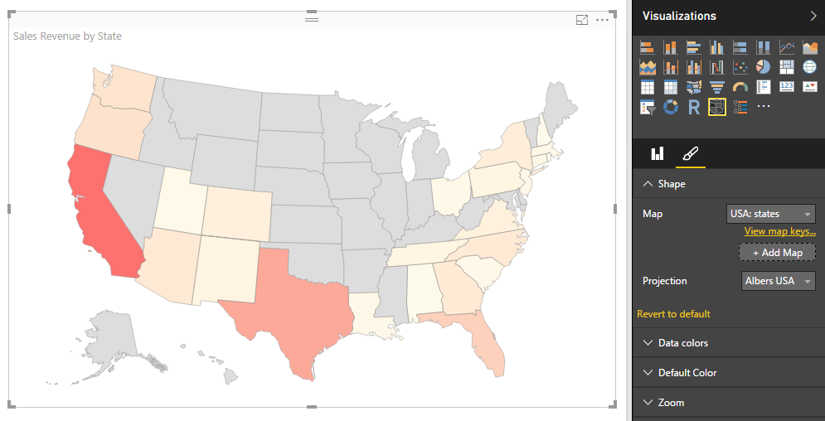
Inline Shape Map
Similar to filled map with a few important exceptions
Based on TopoJSON map format created by ESRI
Allows for creation of custom maps using JSON
Create maps for geography, seating arrangements, floor plans, etc.
In Preview as of August 2016

Slide 17
Exploring Power BI Visuals

Slide 18
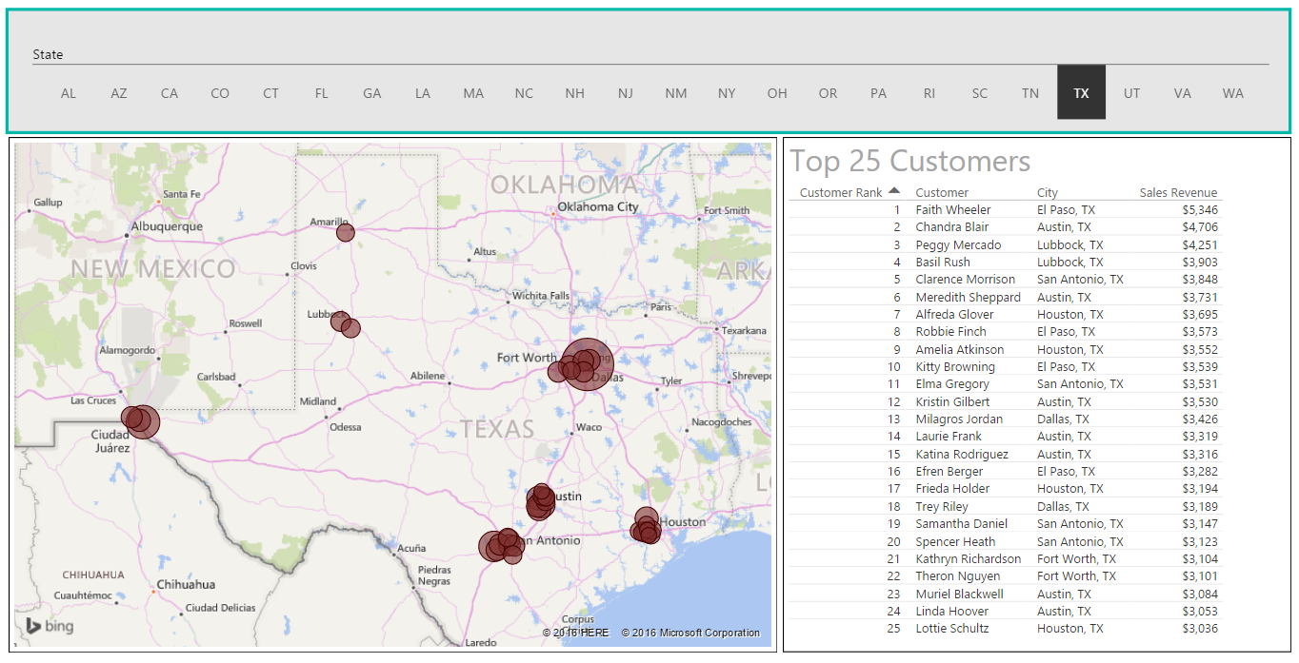
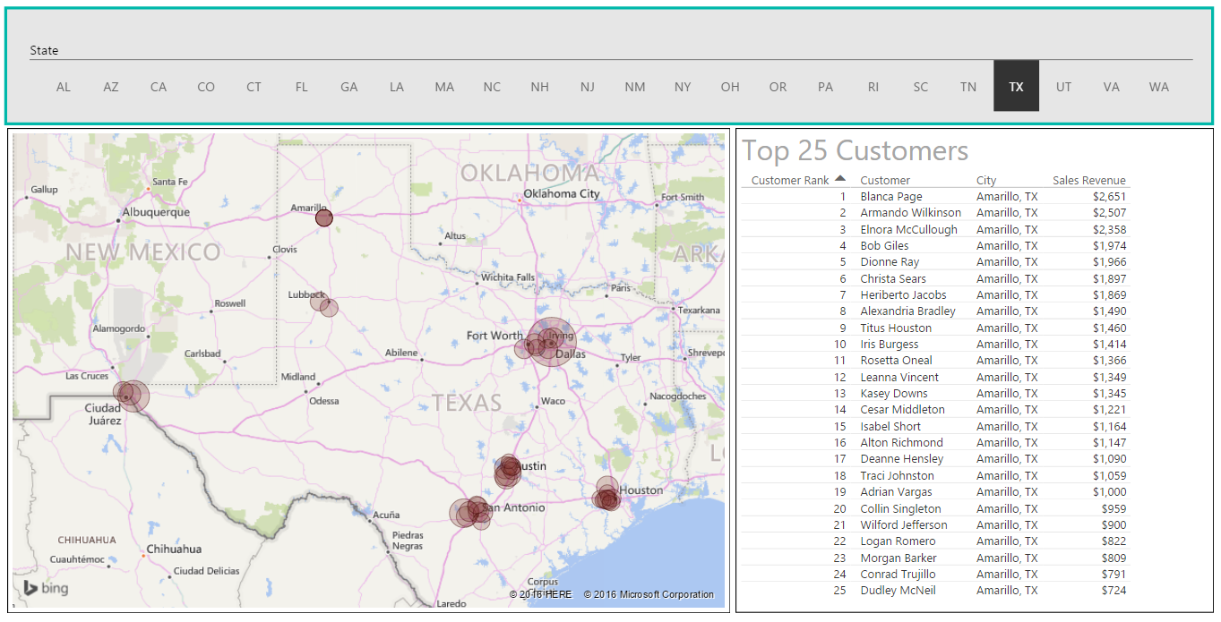
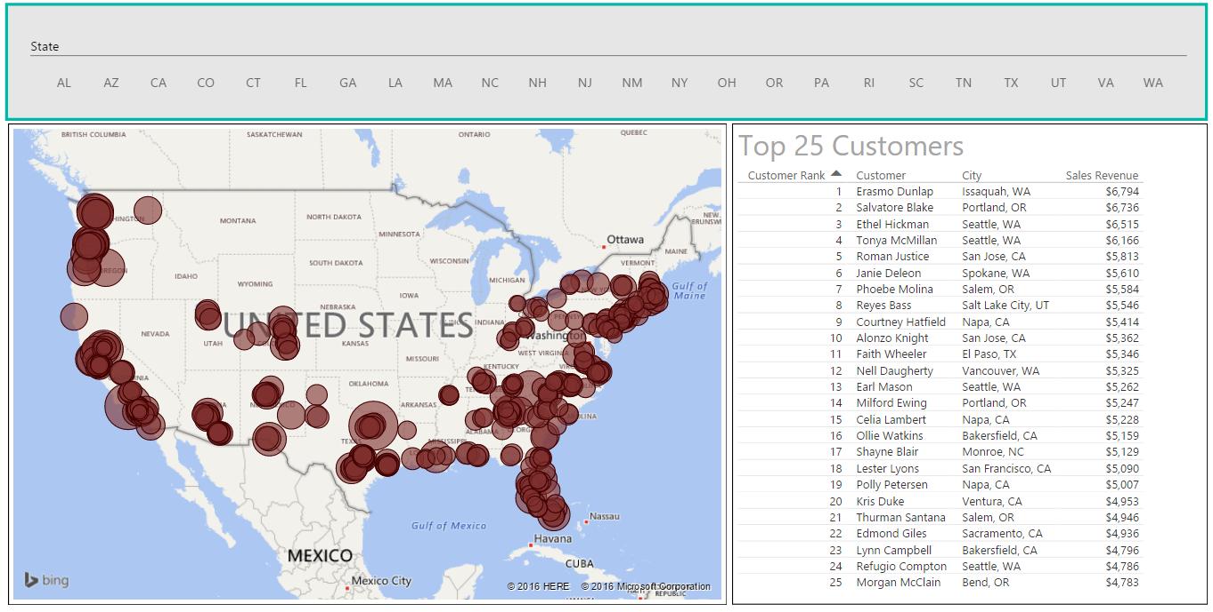
User Interaction with Slicers & Highlighting
Provides user with interactive filtering control
Click to filter
Click again to disable Highlight
Click to Highlight

Slide 19
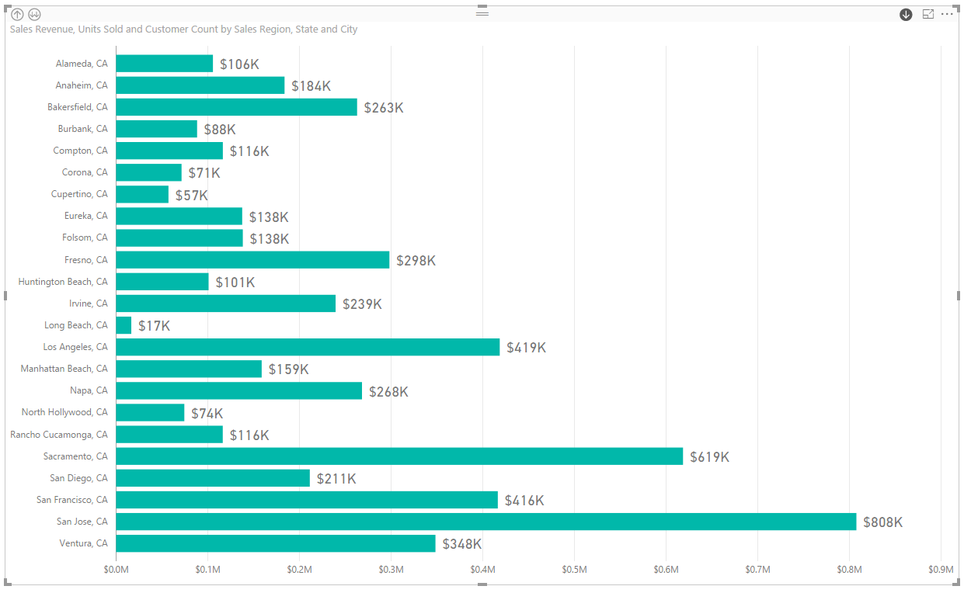
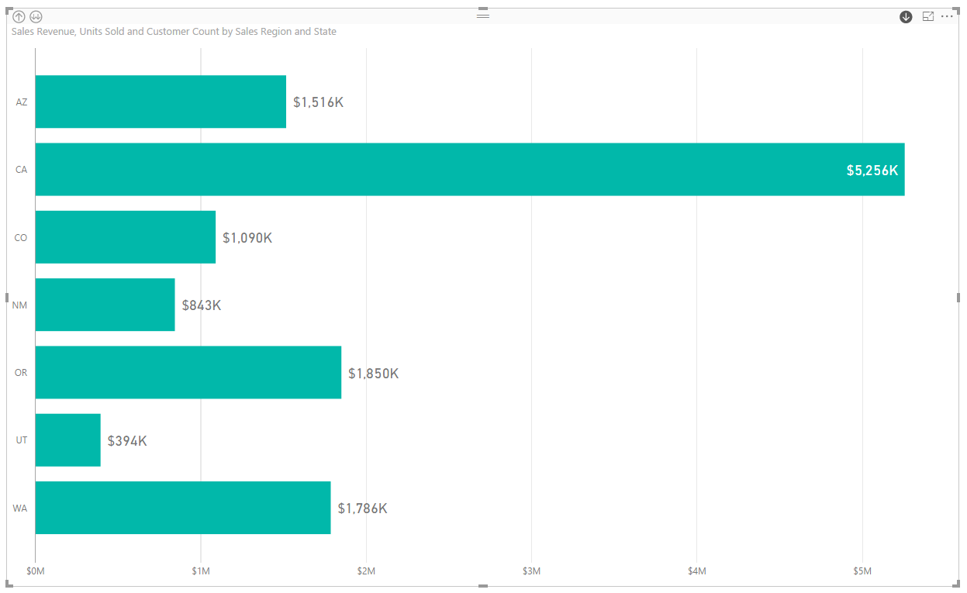
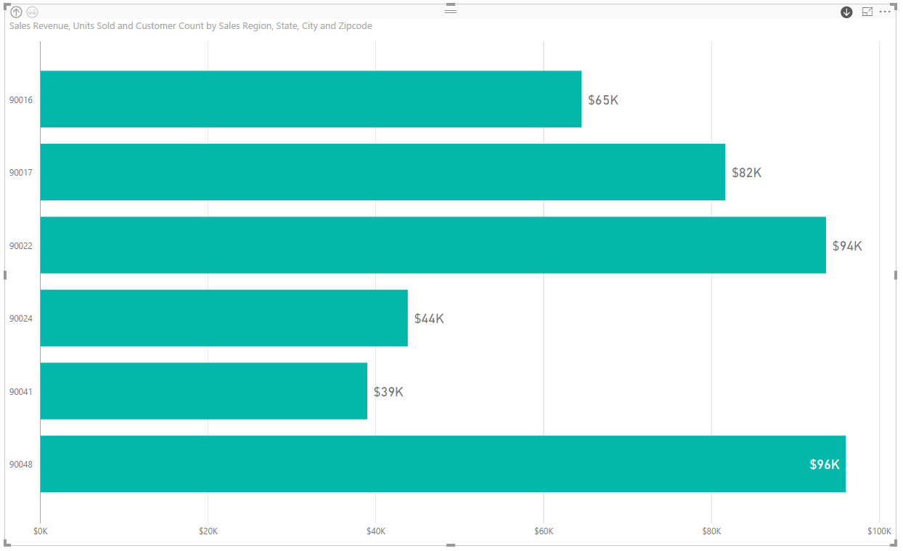
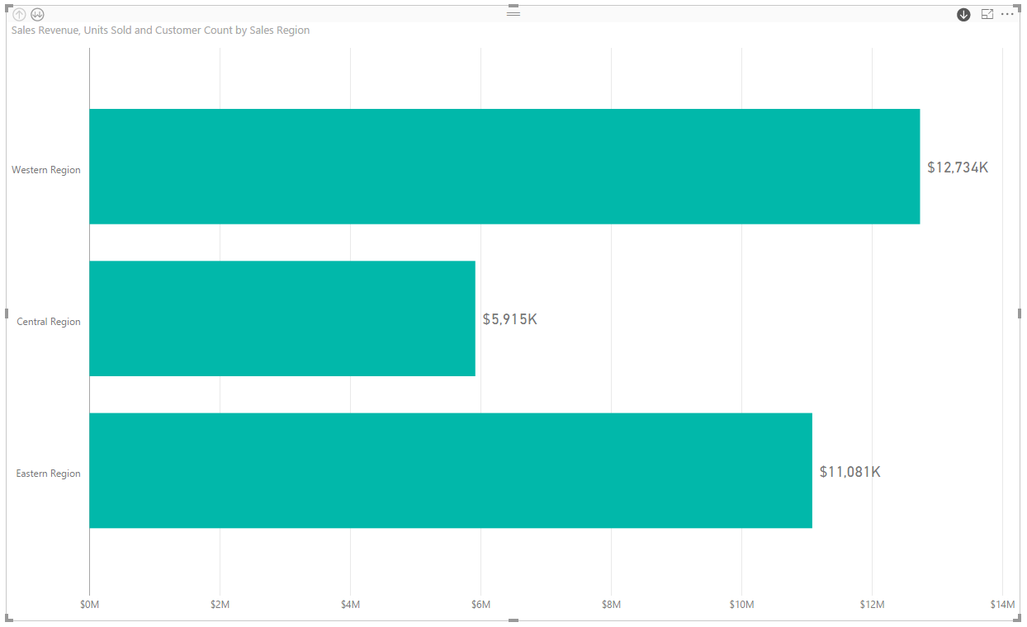
User Interaction using Drill Actions
Drill Actions supported when using hierarchies
You must enabled drilldown mode in visual

Slide 20
Agenda
Designing Interactive Reports
Creating the Top 5 Products List
Working with Bookmarks and Drillthrough
Using Report Themes
Importing Custom Visuals
Publishing Power BI Reports

Slide 21
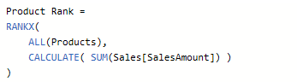
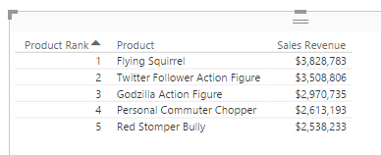
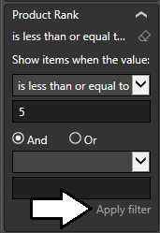
Ranking Products By Sales using RANKX
DAX provides RANKX function for ranking
Can be used to track top 5 products by sales revenue
You can sort and filter on output of RANKX function

Slide 22
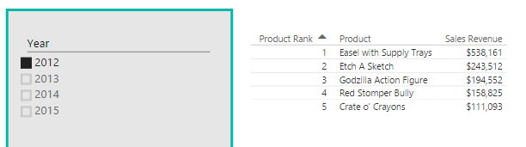
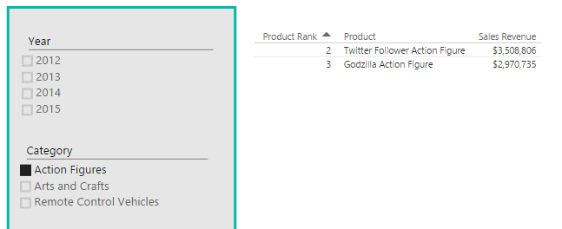
Problems with the Filter Context
RANKX function is affected by filter context
Sometimes you get the results you are expecting
Sometimes you might get unexpected results

Slide 23
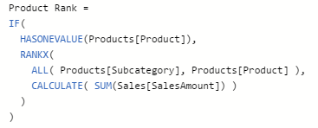
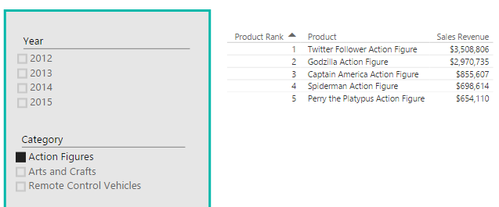
Writing Context Aware DAX Code
When using RANKX…
It’s recommended to call HASONEVALUE function
When calling ALL function, pass one or more columns
Ranking function now evaluates product ranking for specific Category

Slide 24
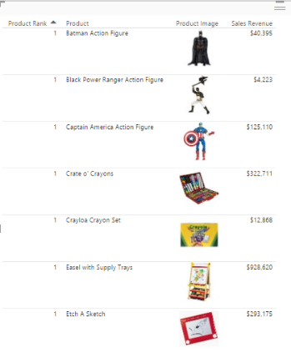
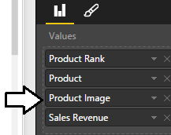
More Ranking Evaluation Problems
Adding new column to table creates new problem
Ranking run separately for each separate Product Image
Every product has unique Product Image and is given rank of 1

Slide 25
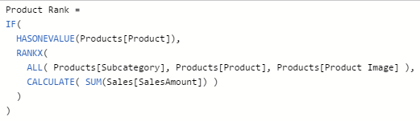
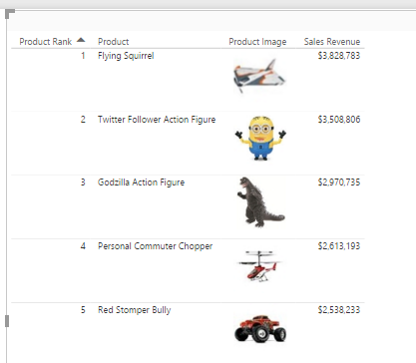
Getting It Right
Call to RANKX must be modified again
You must specify which columns to factor into ranking
Context-aware DAX code corrects problems with visual

Slide 26
Agenda
Designing Interactive Reports
Creating the Top 5 Products List
Working with Bookmarks and Drillthrough
Using Report Themes
Importing Custom Visuals
Publishing Power BI Reports

Slide 27
Working with Bookmarks and Drillthrough

Slide 28
Agenda
Designing Interactive Reports
Creating the Top 5 Products List
Working with Bookmarks and Drillthrough
Using Report Themes
Importing Custom Visuals
Publishing Power BI Reports

Slide 29
Working with Report Themes

Slide 30
Agenda
Designing Interactive Reports
Creating the Top 5 Products List
Working with Bookmarks and Drillthrough
Using Report Themes
Importing Custom Visuals
Publishing Power BI Reports

Slide 31
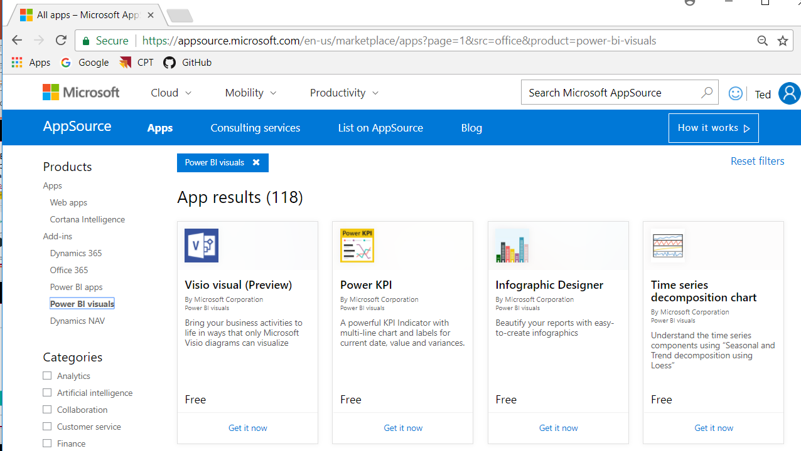
Custom Visuals for Power BI
Power BI Framework for Visuals is Extensible
Developers can extend Power BI with Custom Visuals
Microsoft Hosts gallery of custom visuals
Gallery located at https://appsource.microsoft.com

Slide 32
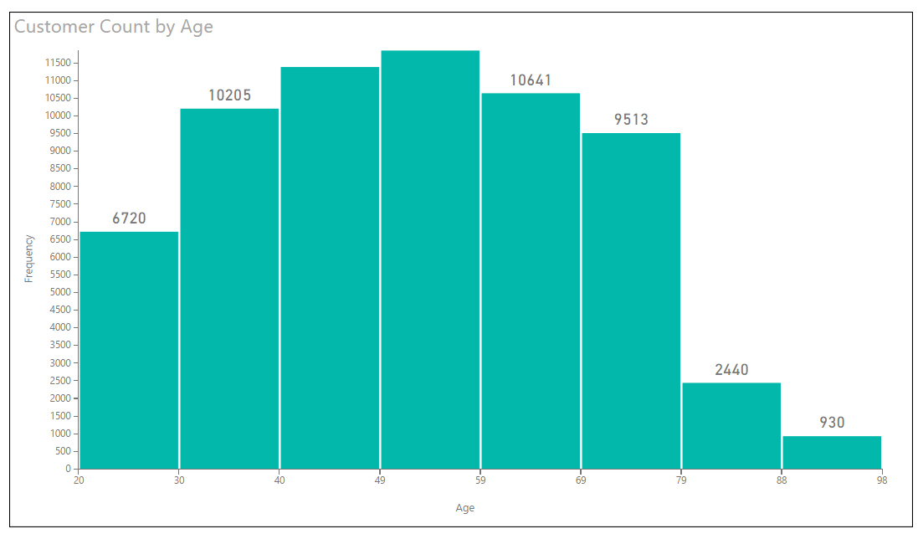
Histogram
Custom Visual Example 1

Slide 33
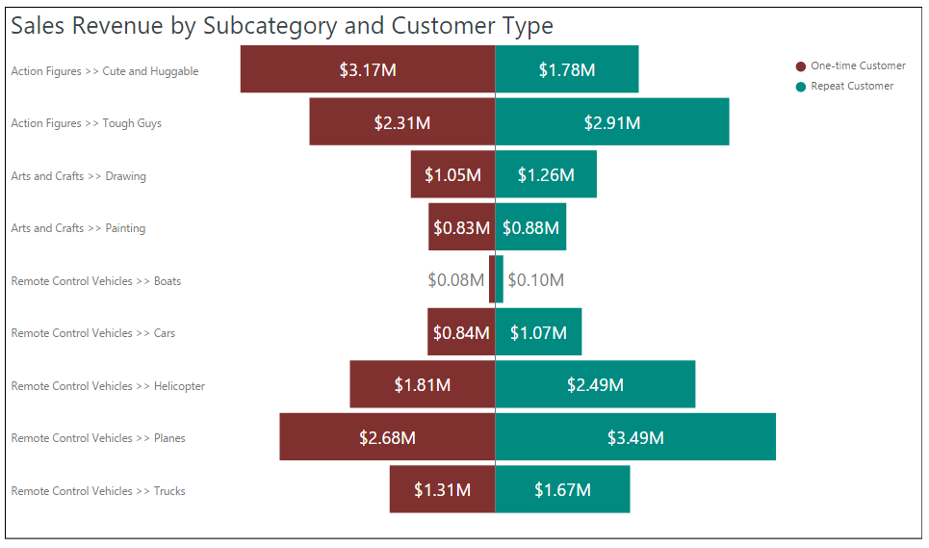
Tornado Chart
Custom Visual Example 2

Slide 34
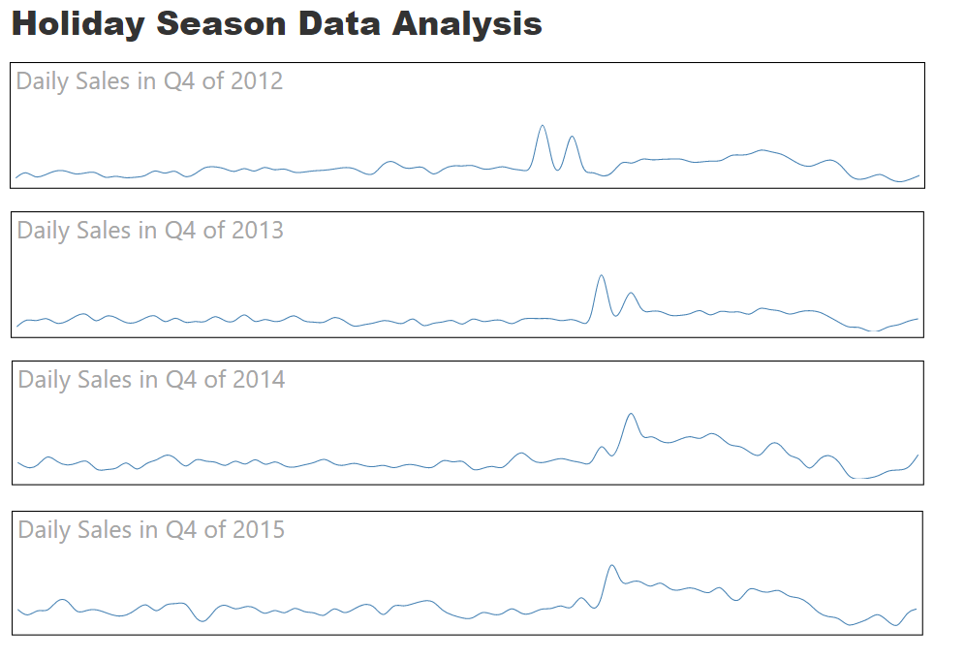
Spark Lines
Custom Visual Example 3

Slide 35
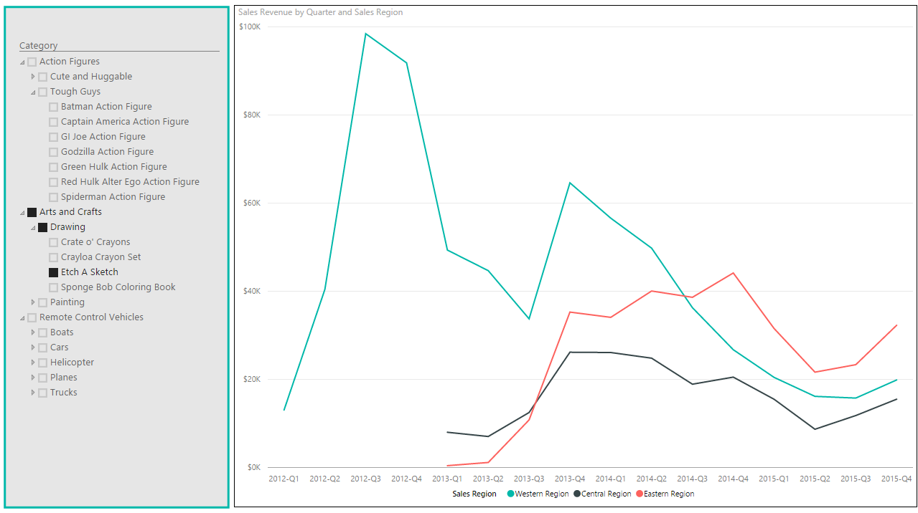
Hierarchy Slicer
Custom Visual Example 4

Slide 36
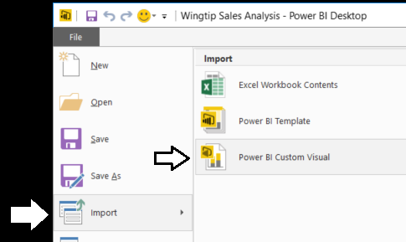
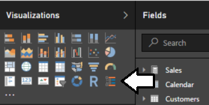
Importing a Custom Visual
Import custom visual into Power BI Desktop project
Execute Import > Power BI Custom Visual menu command
After import, Custom Visual appears in Visualizations list

Slide 37
Agenda
Designing Interactive Reports
Creating the Top 5 Products List
Working with Bookmarks and Drillthrough
Importing Custom Visuals
Publishing Power BI Reports

Slide 38
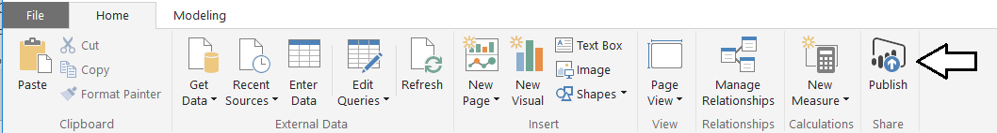
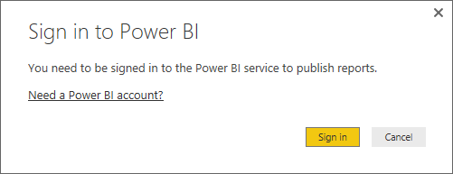
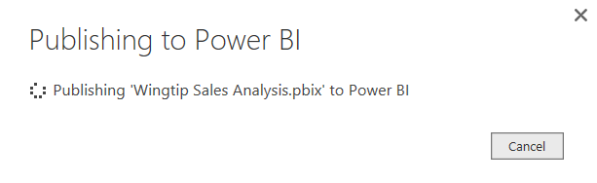
Publishing a Power BI Desktop Project
Power BI Desktop provides Publish command
Used to publish project to Power BI service
Requires logging into your Office 365 account
Published articles added to a specific workspace

Slide 39
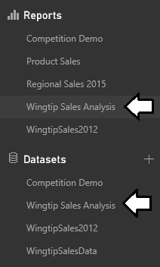
Examining What's Been Published
What does project publishing add to workspace?
One dataset with same name as project
One report with same name as project

Slide 40
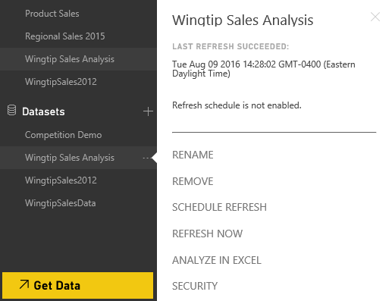
Dataset Configuration
You can configure Dataset after its been published
Configure data source credentials
Configure refresh schedule
Configure Row-level Security

Slide 41
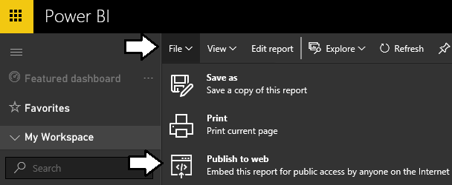
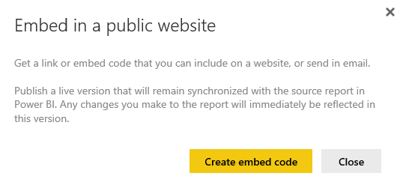
Publish to Web
Publish to Web command available on reports
Not supported for reports and datasets which implement RLS
Publish to Web command used to generate embed codes

Slide 42
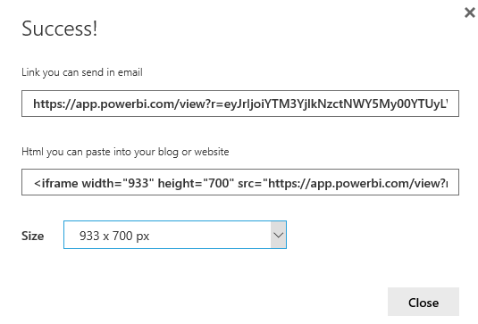

Generating Embed Codes
Used to provide anonymous access to report
Provide link which can be posted, emailed or texted
Provides iFrame HTML element for embedding in public web site

Slide 43
Summary
Designing Interactive Reports
Creating the Top 5 Products List
Working with Bookmarks and Drillthrough
Importing Custom Visuals
Publishing Power BI Reports

